Slide 1
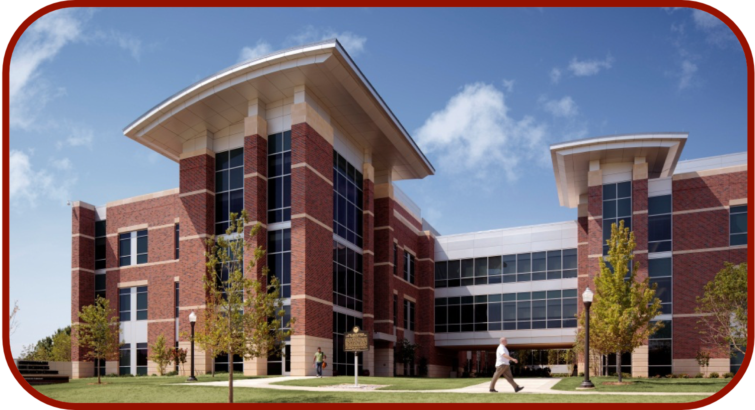
RoseTTAFold and Protein Structure Prediction
CCATS Group

Slide 2
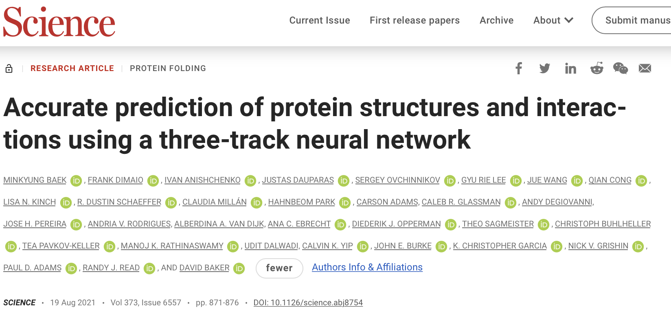
RoseTTAFold
https://github.com/RosettaCommons/RoseTTAFold
Baek et al., Science, 2021, 373, 871

Slide 3
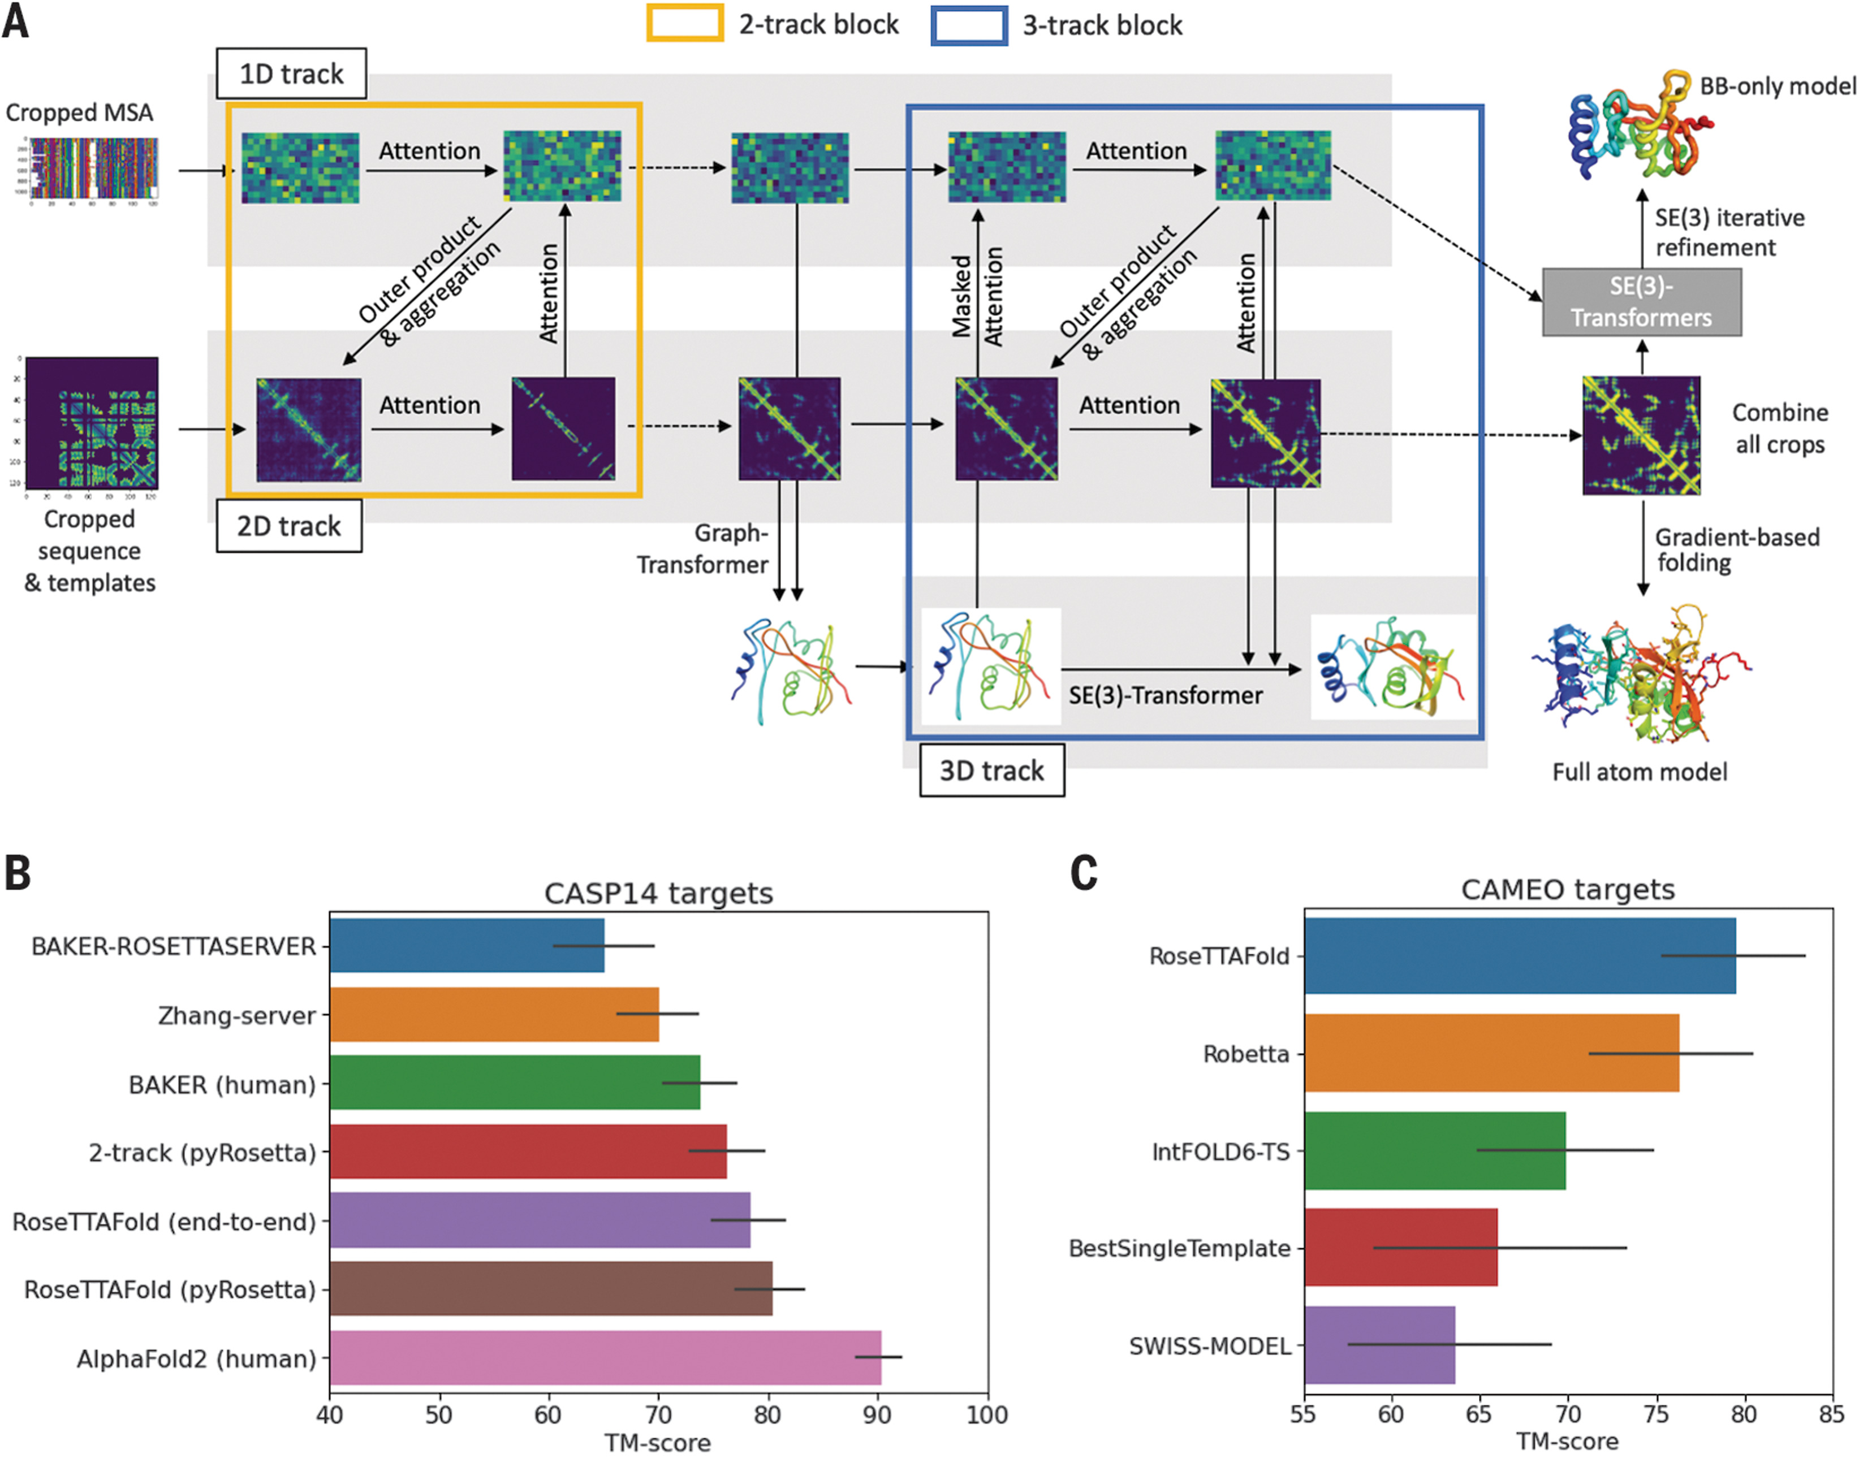
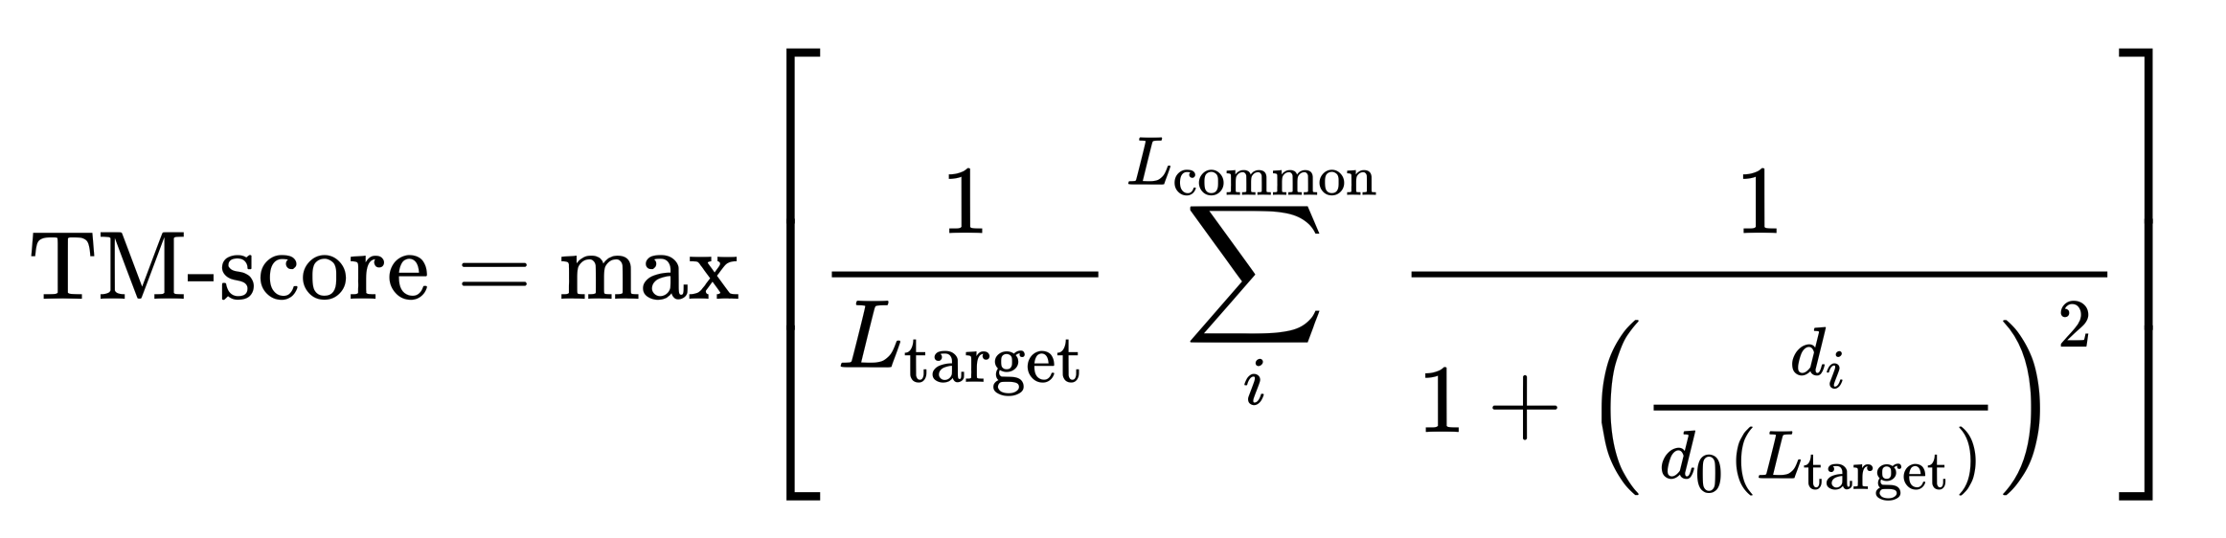
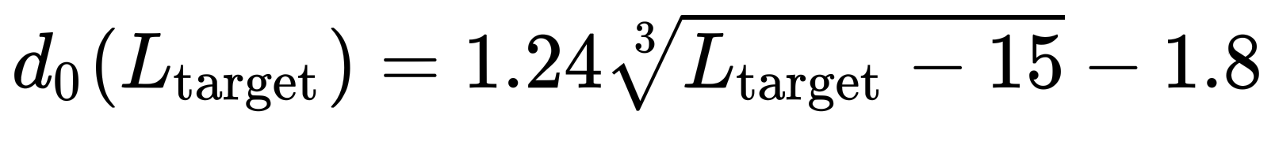
RoseTTAFold Comparison
TM-score (Template Modelling)
Baek et al., Science, 2021, 373, 871

Slide 4
RoseTTAFold Schematic
Baek et al., Science, 2021, 373, 871

Slide 5
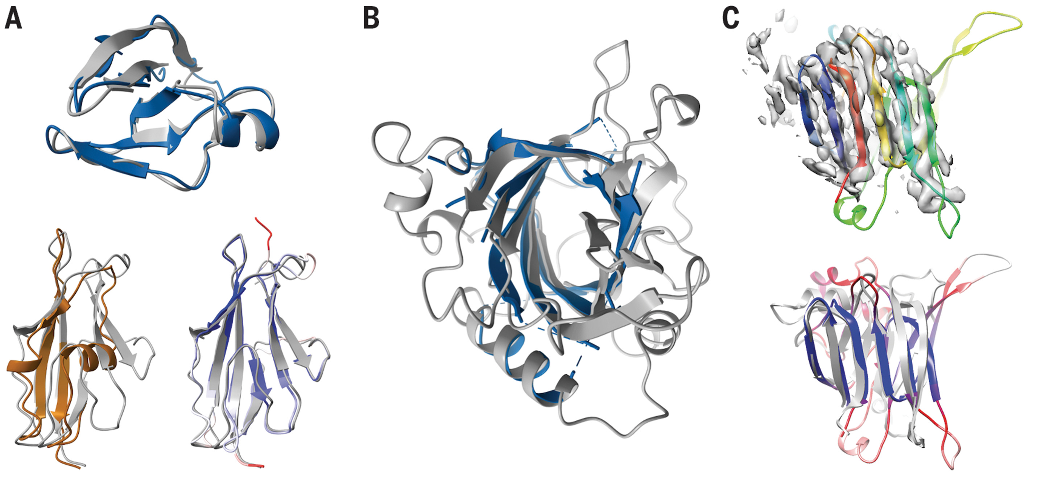
RoseTTAFold Predictions of Protein Structures
SLP
Lrbp
PI3K_{𝛾}
Baek et al., Science, 2021, 373, 871

Slide 6
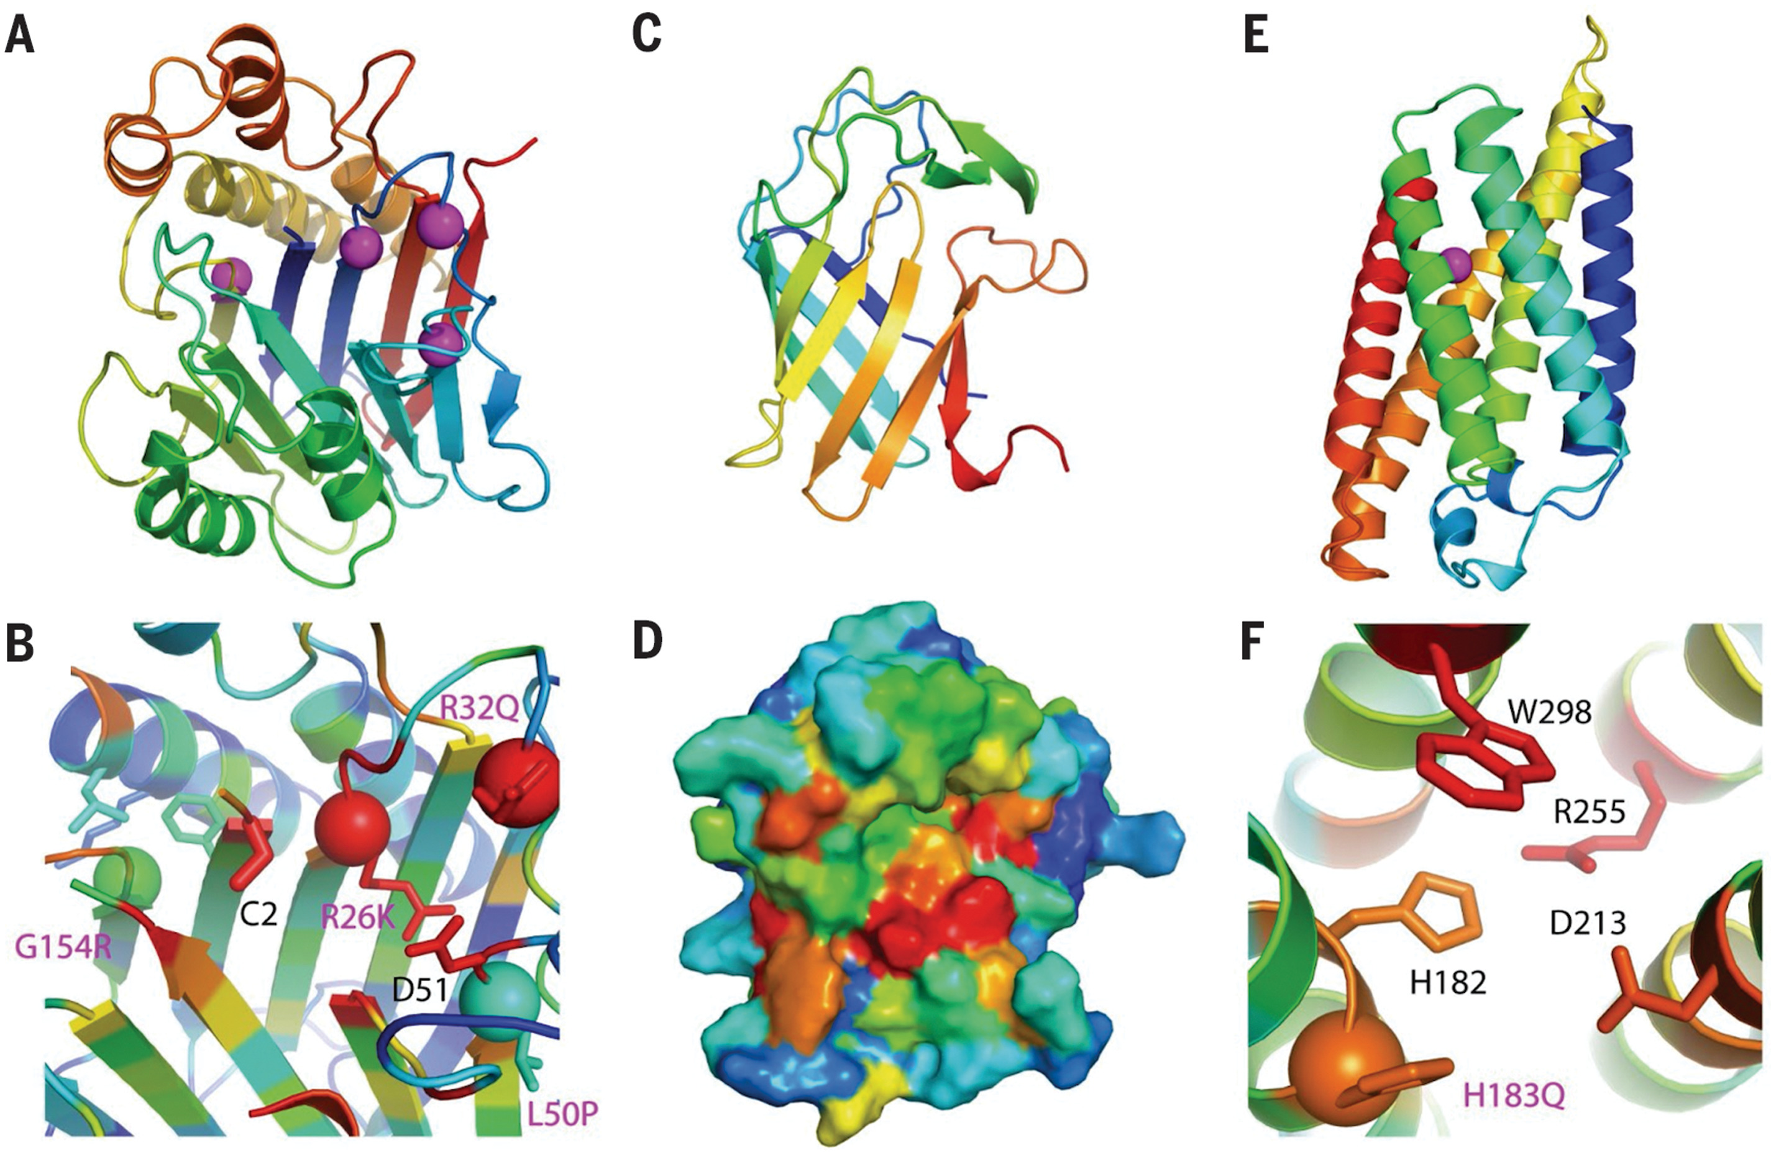
RoseTTAFold-Predicted Protein Functions
TANGO2
ADAM33
CERS1
Baek et al., Science, 2021, 373, 871

Slide 7
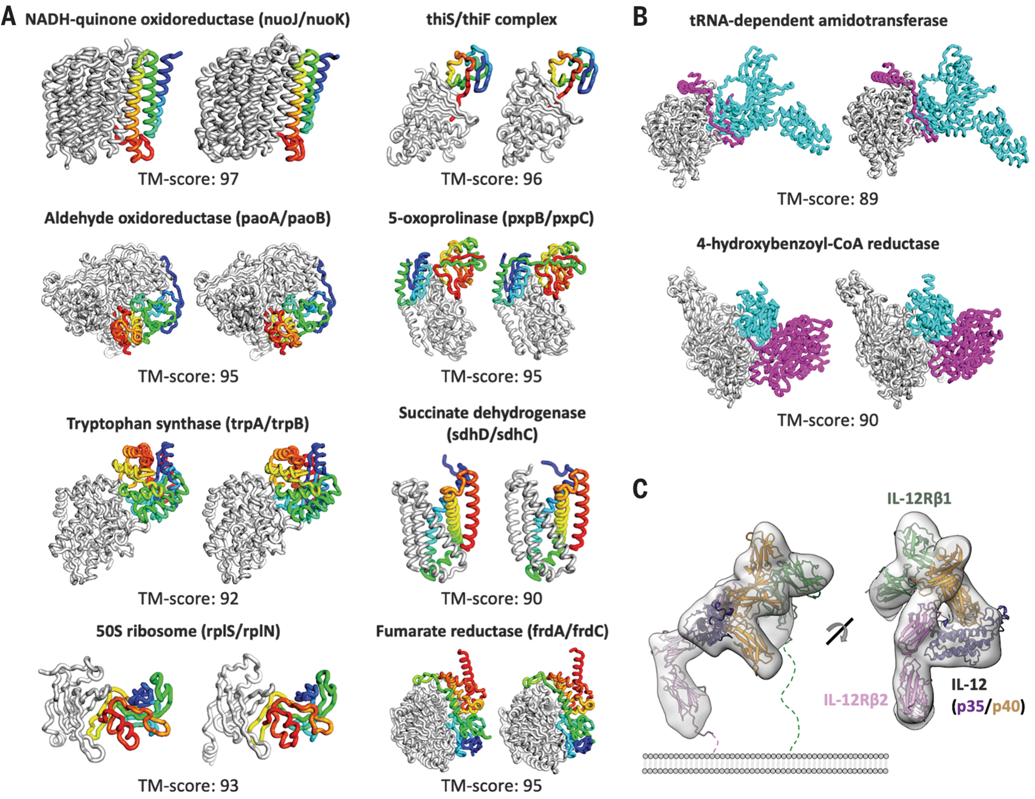
RoseTTAFold-Predicted Structure of Protein Complexes

Slide 8
RoseTTAFold Workflow
Input sequence
Amino Acid Sequence in FASTA format (.fa)
RoseTTAFold Program
Conda Environments (GPU, Folding; ~3.8 Gb)
RoseTTAFold Software (~6.9 Gb)
PyRoseTTA License (https://els2.comotion.uw.edu/product/pyrosetta)
RoseTTAFold Databases (~460 Gb)
Uniref30, Reduced BFD/Mgnify, Structure Templates (RCSB)
If all goes well, you get 5 predicted monomer structures

Slide 9
03_rosettafold
On OSCER, copy this directory to your home:
cp /home/van/MacroMol_Modelling_Tutorial/03_rosettafold .
The folder is organized as follow:
> 03_rosettafold
> Results
> Tutorial
> 00_monomer_pred
> 01_complex_pred

Slide 10
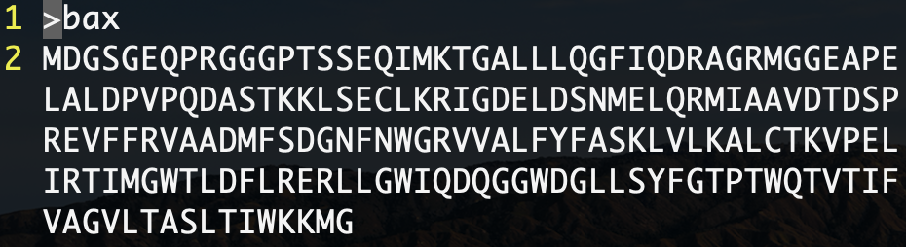
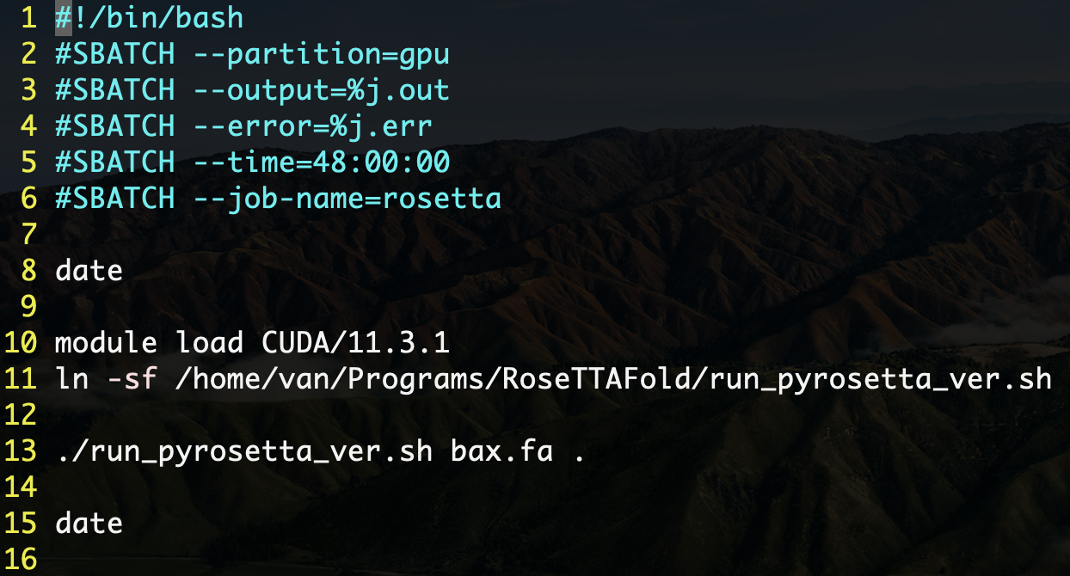
03_rosettafold/Tutorial/00_monomer_pred
bax.fa (Bax FASTA sequence)
This folder contains:
bax.fa (Bax)
rf_monomer_pred.slurm
SLURM script to run RoseTTAFold
To run:
sbatch rf_monomer_pred.slurm
rf_monomer_pred.slurm
SLURM Allocation requests
Load CUDA library (for GPU)
Create link of RoseTTAFold Script and run the program taking the FASTA sequence as input 1 and “.” as the working directory

Slide 11



run_pyrosetta.sh (made by Van)
RF run_pyrosetta.sh [input FASTA] [working directory]
Monomer Prediction
RF RosettaTR.py \
[input FASTA] [input.3track > [input.pdb]
conda activate
RoseTTAFold
Prepare MSA
RF make_msa.sh [input FASTA] > [input.a3m]
Error Estimation (DeepAccNet-MSA)
RF ErrorPredictorMSA.py \
[input.3track] > [input.crderr.pdb]
Predict Secondary Structure
RF make_ss.sh [input.a3m] > [input.ss2]
conda activate folding
5 Predicted Models
(with separate PDB for error)
Search Templates
Combine [input.a3m] [input.ss2] > [input.msa0.ss2.a3m]
HHsearch [input.msa0.ss2.a3m] > [input.hhr] & [input.atab]
Predict Distance & Orientation
RF predict_pyrosetta.py \
[input.a3m] [input.hhr] [input.a3m] > [input.3track]
NOTE:
Bold : program
Italic : scripts
[name] : name of input (auto)
RF : RoseTTAFold

Slide 12
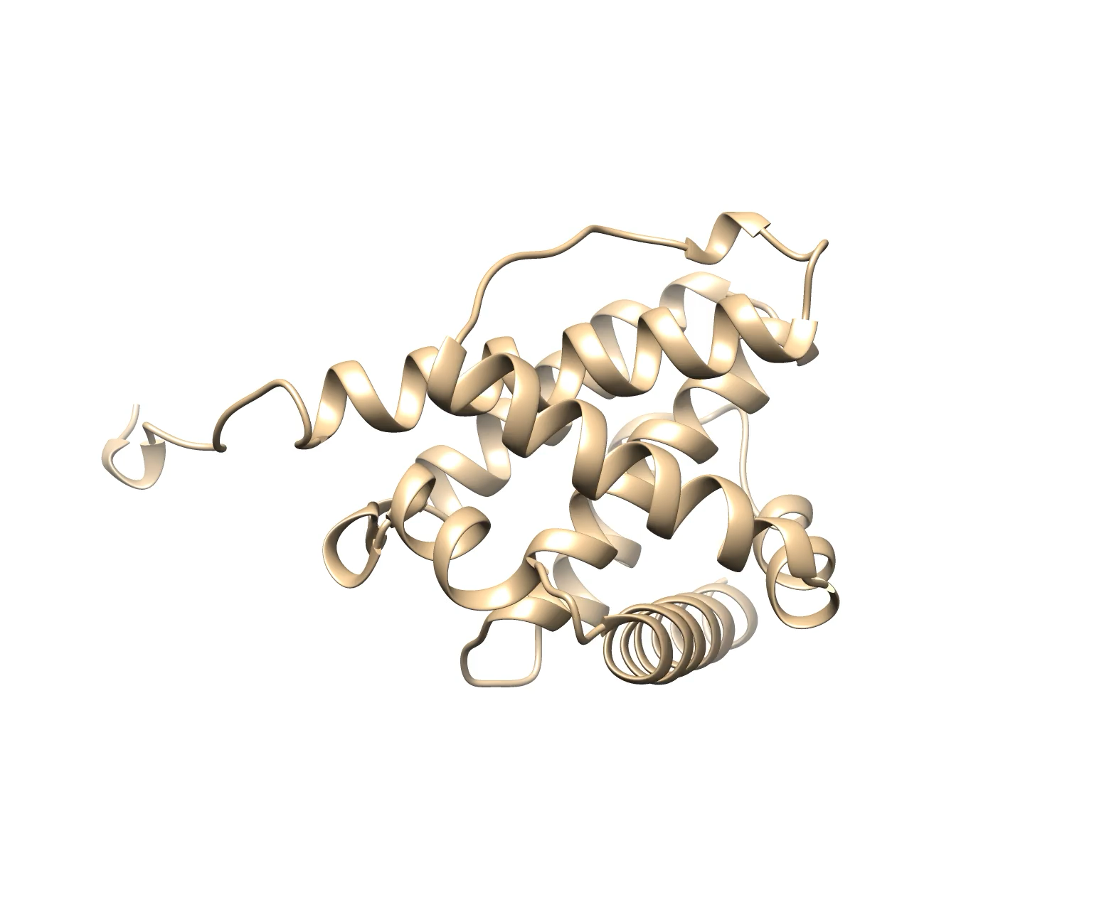
Visualizing Model 1 Error on UCSF Chimera
Download the models folder to your local computer
Load model_1.crderr.pdb on Chimera
Change atom coloring to error (found in B Factor column)
Select > Structure > protein
Action > Atom/bonds > Show
Tools > Depiction > Render by Attribute

Slide 13
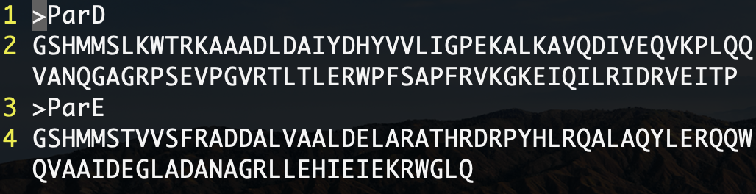
03_rosettafold/Tutorial/01_complex_pred.slurm
This folder contains:
paparde.fa (from Alphafold Tutorial)
Need to make two separate FASTA files:
head -n 2 paparde.fasta > pard.fa
tail -n 2 paparde.fasta > pare.fa
rf_complex_pred.slurm
SLURM script to run RoseTTAFold
To Run:
sbatch rf_complex.slurm
paparde.fa (from Alphafold

Slide 14
rf_complex_pred.slurm (made by Van)
(van) conda activate RoseTTAFold
Copy from RoseTTAFold (RF):
make_joint_MSA_bacterial.py
make_msa.py (2track)
predict_complex.py
OPTIONAL
Complex Template Prediction
RF predict_msa.py paired.a3m > complex.npz
conda activate
folding
Complex Prediction
RF predict_complex.py \
filtered.a3m > model_#_SML_P.pdb> complex.pdb
Prepare MSA for each subunit
RF make_msa.sh \
[subunit1 FASTA] > [subunit1.a3m]
RF make_msa.sh \
[subunit2 FASTA] > [subunit2.a3m]
Generate Sidechains and Error Prediction
RF RosettaTR.py \
complex.pdb [input FASTA] [input.3track] > [output.pdb]
Make Pair Alignments
RF make_joint_MSA_bacterial.py \
[subunit1.a3m] [subunit2.a3m] > paired.a3m
Filter Pair Alignment
HHfilter paired.a3m > filtered.a3m
NOTE:
bold-underline : constant file name

